Slide 1
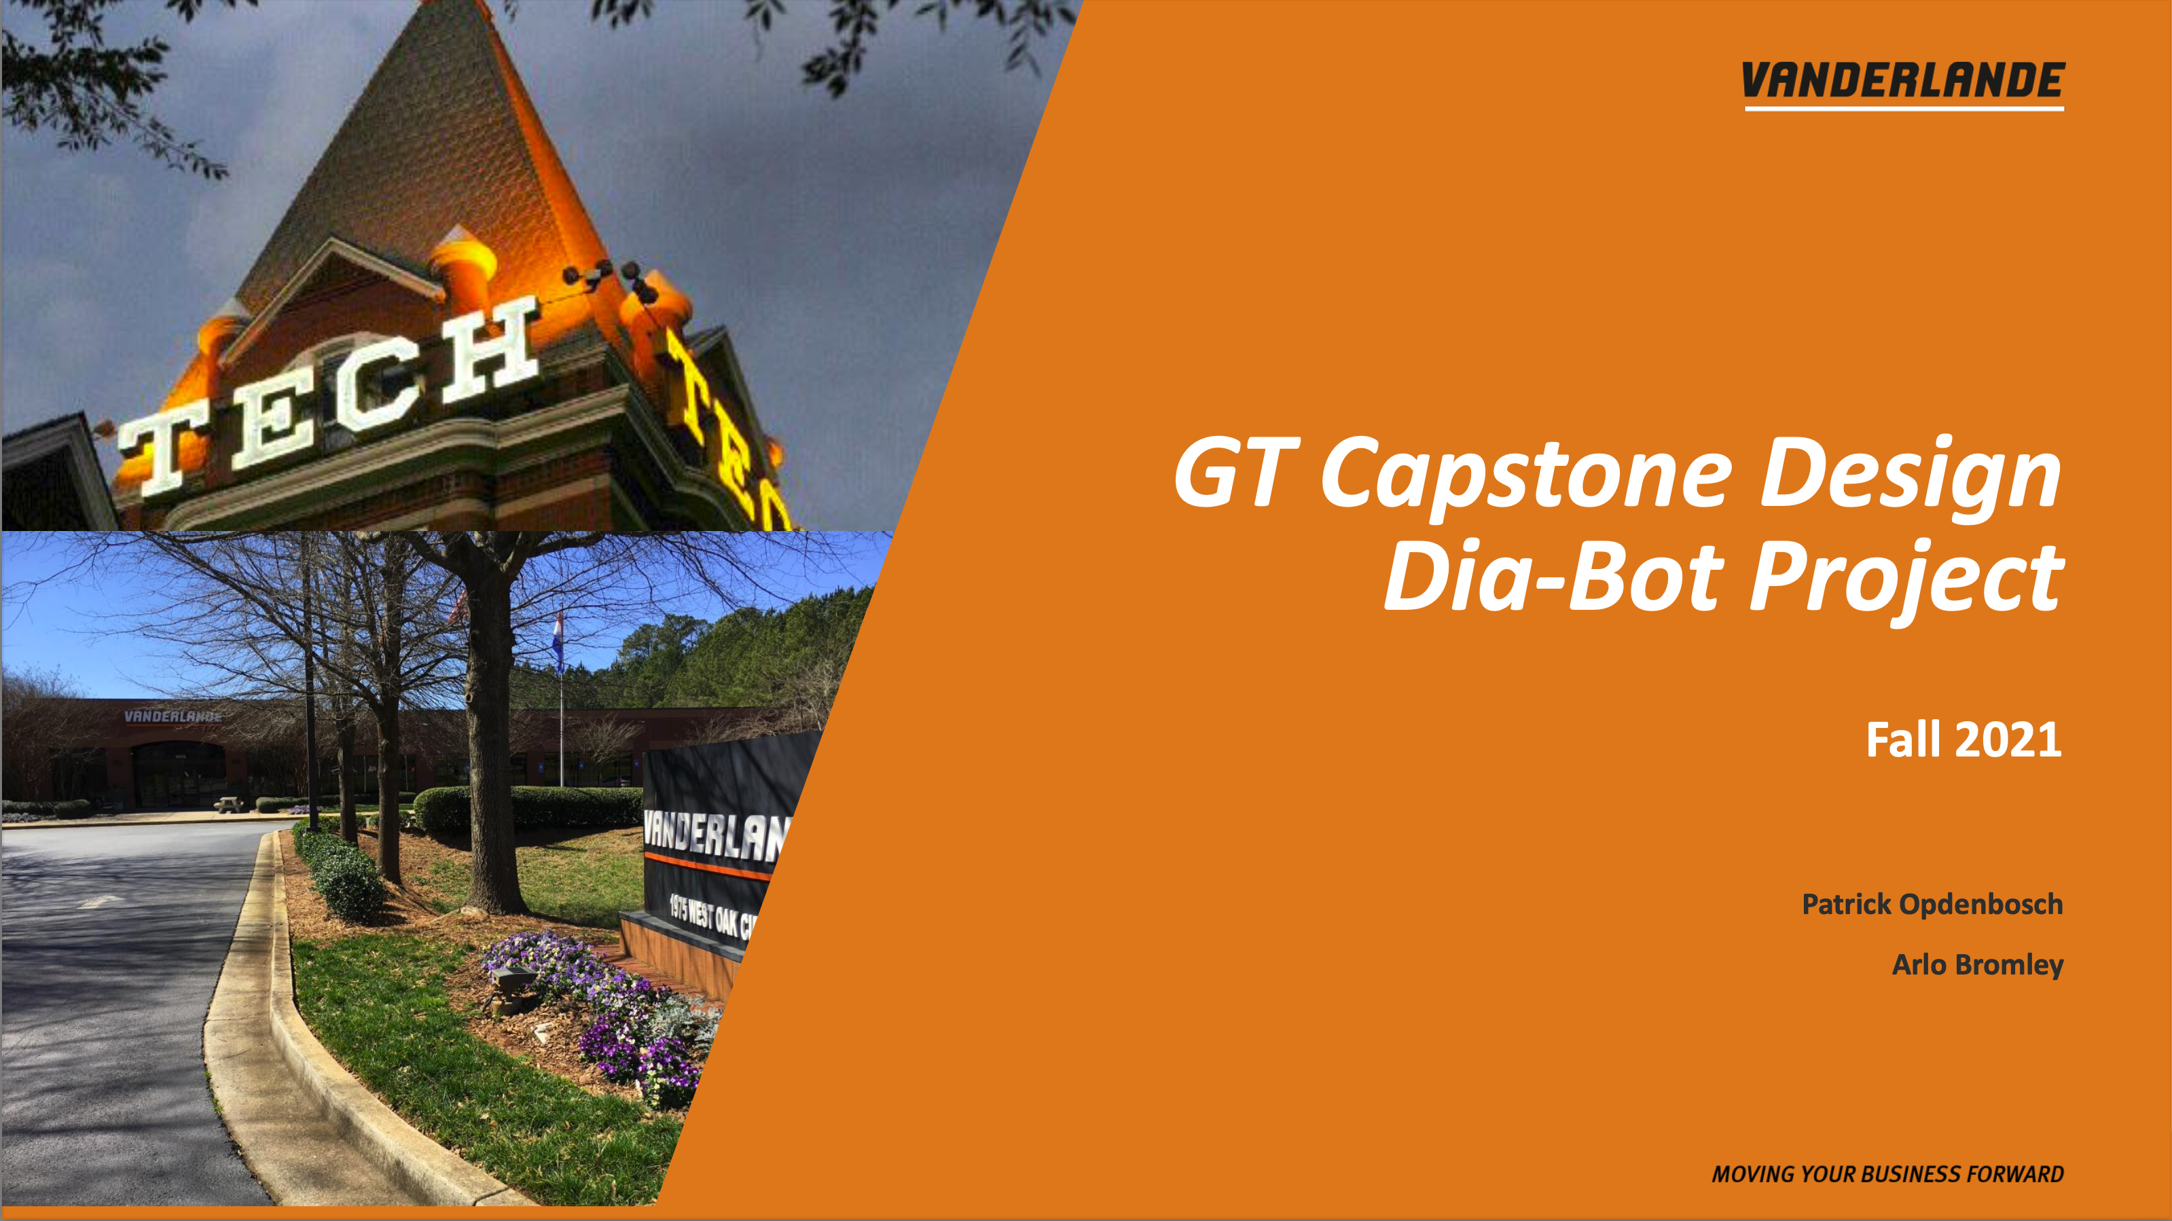

GT Capstone Design
Dia-Bot Introductory
Design Report
Operation Omega
Andrew Galant (ME), Catherine Kasper (CmpE), Jason Piotter (ME),
Hunter Present (ME), Connor Truono (CmpE), & Douglas Walker (ME)

Slide 2

Presentation Content
Problem Statement
Function Tree
Specifications
Design Methodology & Concepts
Features & User Interface
Electrical
Mechanical
Problem Alert Examples
Stretch Goals & Future Work
Project Timeline

Slide 3
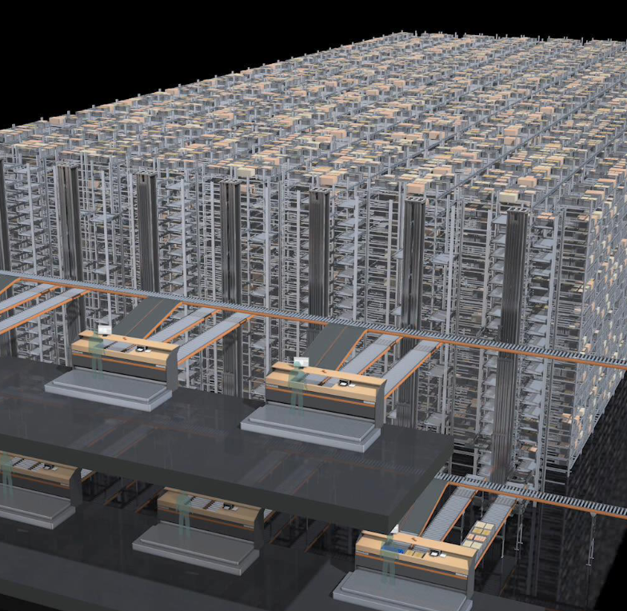
Problem Statement
Design and build a diagnostic robot (”Dia-Bot”) to identify potential installation issues in Vanderlande’s shuttle and conveyor systems

Slide 4
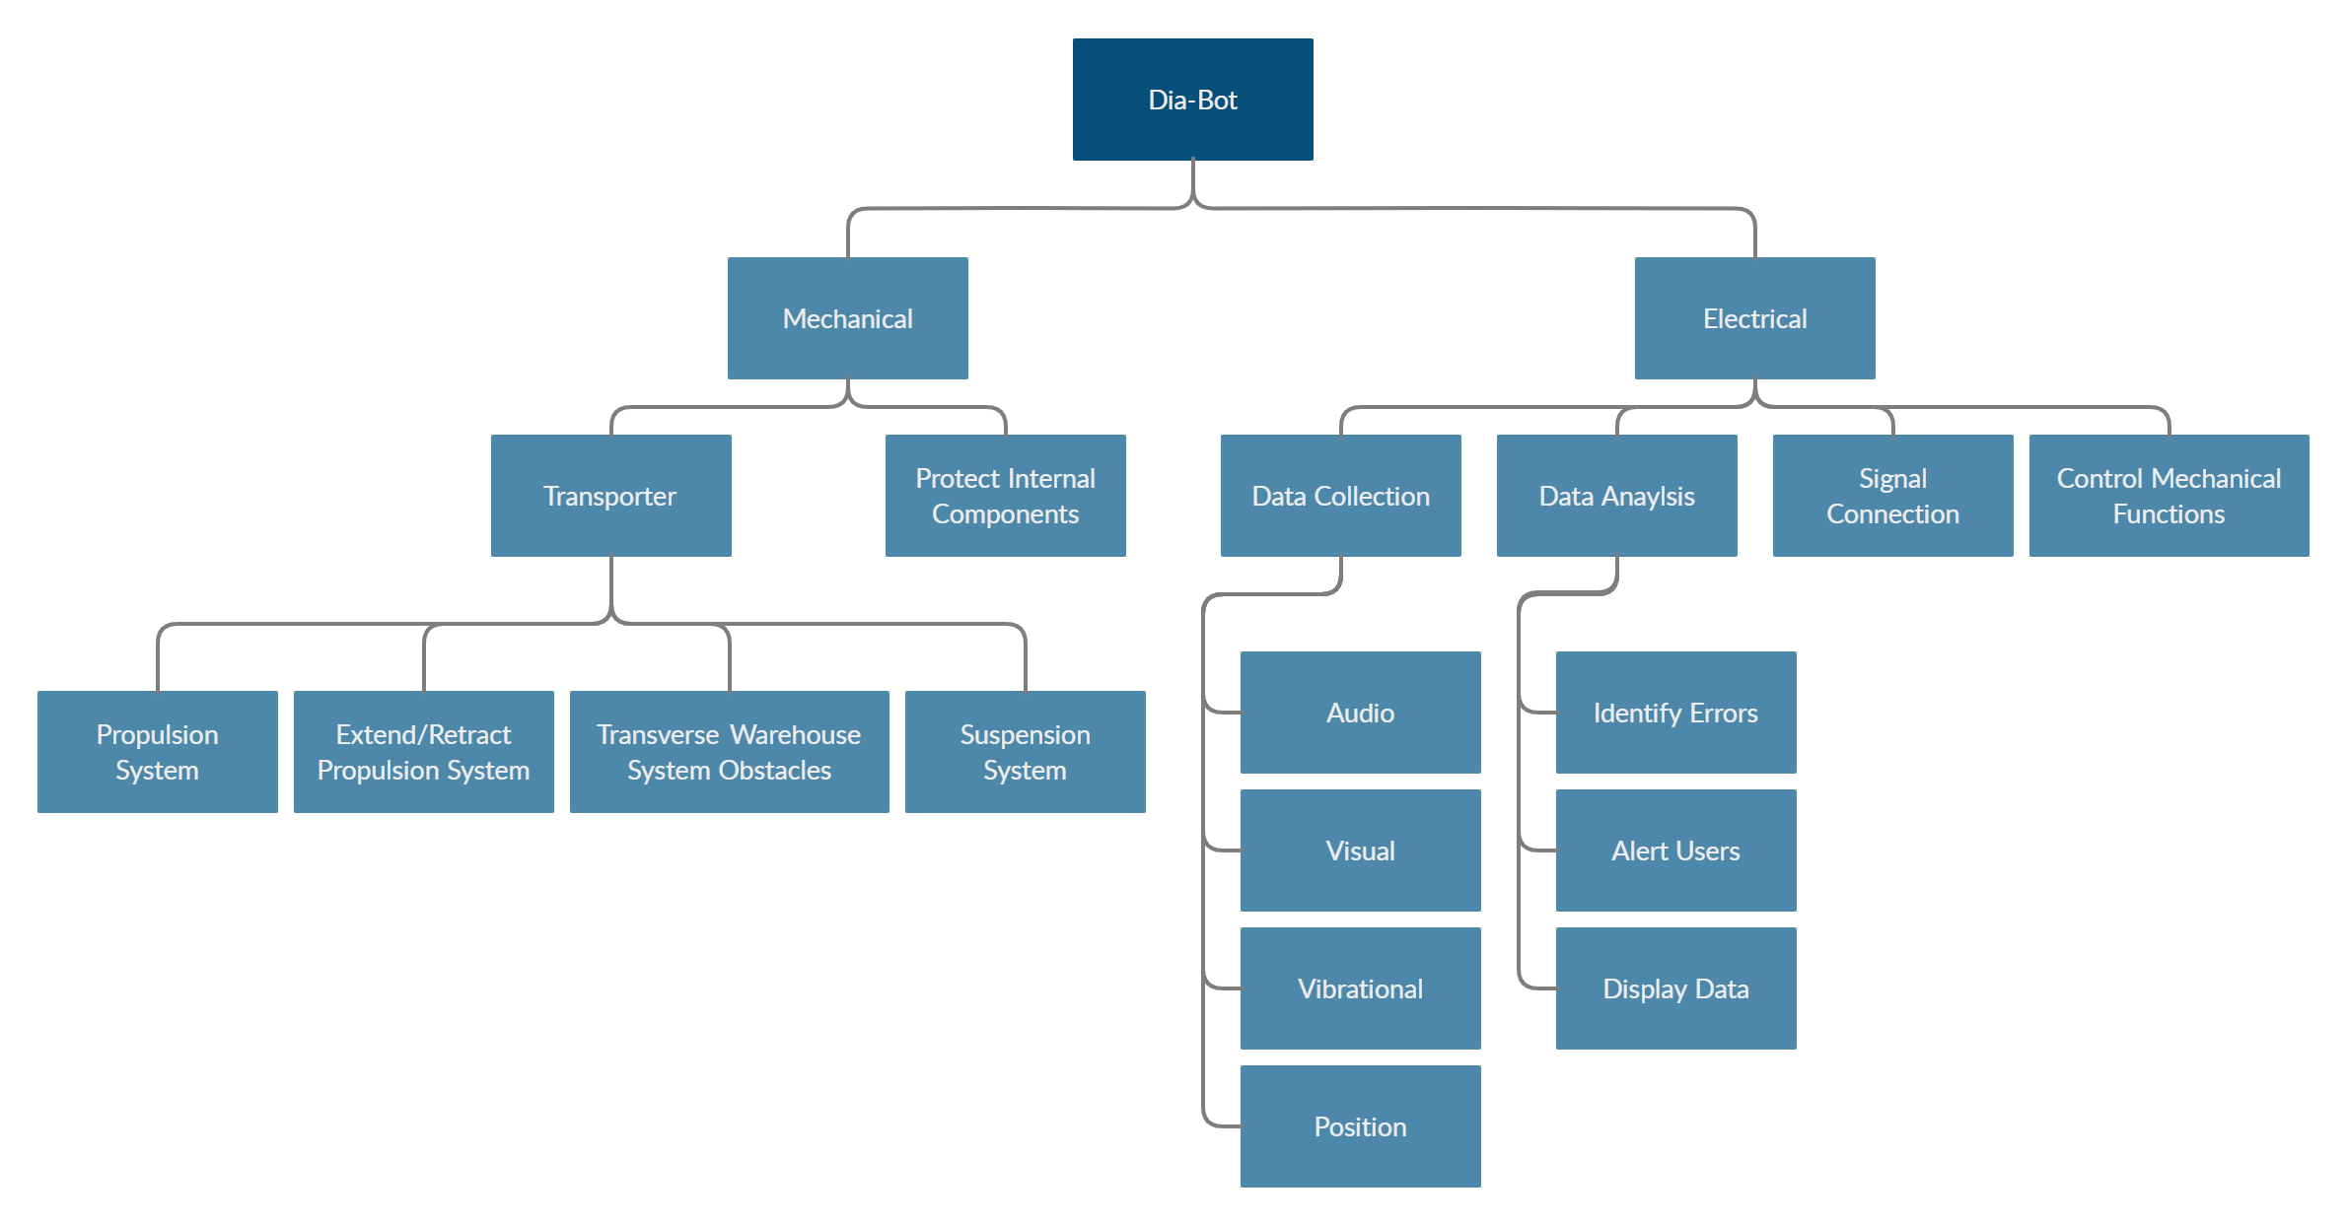
Function Tree

Slide 5
Specifications
The following will be considered in the design:
Bot should be conveyable on traditional conveyor surfaces and traverse normal transitions
Belts, rollers, curves, diverts
Inclines, declines, merges, diverges
In addition to being conveyed, this bot must also traverse those machines under its own power
Robust enough to withstand the vibration induced while navigating the system
Must fit within a 650mm x 450mm footprint within a height of 320mm
Maximum weight of 35kg allowed by conveyor systems
On board camera remotely controlled to provide 360° rotation and vertical tilting
Ability to track the bot’s position within the system to an accuracy of ± 12”
Track accelerative forces seen by a product through normal handling
Measure vibration and sound levels to help identify problems

Slide 6
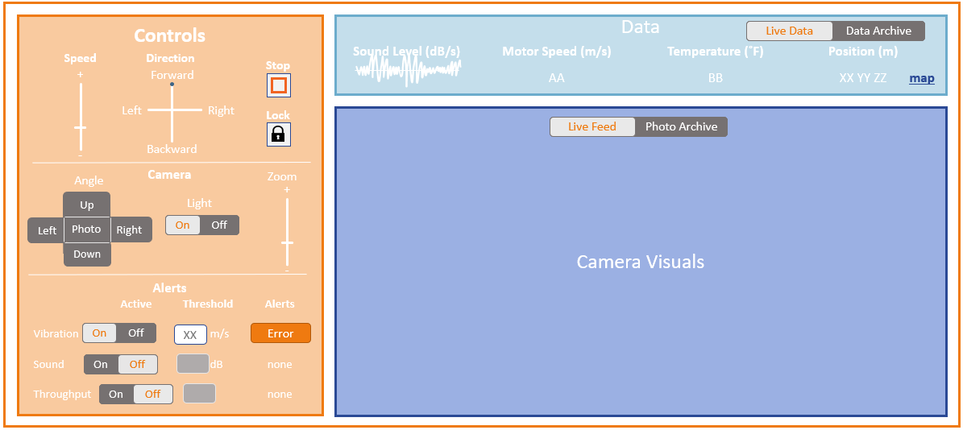
Design Concept: Features & User Interface
Features
Movement
Speed and Direction
Raise Treads + Suspension Lock
Emergency Stop
Problem Alerts
Preset and Custom Triggers
Camera Controls
Direction
Zoom
Light
Live Data Streaming
Camera Feed
Sensors
Notes:
For initial design validation, off the shelf components and
Other problems and use cases will undoubtedly be discovered over time
More specific features will be required
Our goal is to give Vanderlande a functioning platform with the right tools to easily program future solutions

Slide 7

Design Concept: User Interface (Alternate)
Camera Visuals
Live Camera
Data Archive
Controls
Data
Alerts
_
_
Light
Zoom
Angle
Speed
Direction
 | Active | Threshold | Alerts
Vibration |  | m/s
Sound |  | dB | none
Throughput |  |  | none
Motor Speed
+
+
Forward
Stop
On
Off
Up
On
Off
Error
XX m/s
Left
Photo
Right
Left
Right
Lock
Location (m, m, m)
Down
On
Off
-
-
Backward
On
Off
XX
(XX, YY, ZZ)

Slide 8


Design Concept: User Interface (Data View)
Camera Visuals
Data
Live Data & Data Archive
Live Camera
Data Archive
Sound Level (dB/s) | Motor Speed (m/s) | Temperature (˚F) | Position (m) | Vibration Levels
 | 00 When viewing data, the robot will automatically stop
Timestamp | Location
09/28/2021 10:30 AM | XX YY ZZ
09/28/2021 10:20 AM | XX YY ZZ
09/28/2021 10:10 AM | XX YY ZZ
X direction
Y direction
Controls
Alerts
_
X
Light
Zoom
Angle
Speed
Direction
 | Active | Threshold | Alerts
Vibration |  | m/s
Sound |  | dB | none
Throughput |  |  | none
+
+
Forward
Stop
Z direction
On
Off
Up
On
Off
Error
Left
Photo
Right
Left
Right
Lock
Down
On
Off
-
-
Backward
On
Off
XX

Slide 9

Design Concept: Electrical
On Dia-Bot
Source Voltage
Voltage
DC Voltage Converter
Rechargeable Battery
User Interface
Web Format
vibration
Accelerometer
Web Page
sound
Microphone
Data Outputs
Voltage
environment
Camera
Raspberry Pi
Processing & System Controls
Voltage
light
LED
Wi-Fi module
Voltage
Motor
Left Tread
Motor
Rotates Camera 360˚
Voltage
Voltage
Motor
Right Tread
Motor
Tilts Camera Angle
Voltage
Voltage
Servo
Locks Suspension
Motor
Lowers bottom panel
Voltage
Note: Voltage calculations and suspension locked have not been finalized and will depend on part selection and design validation.

Slide 10
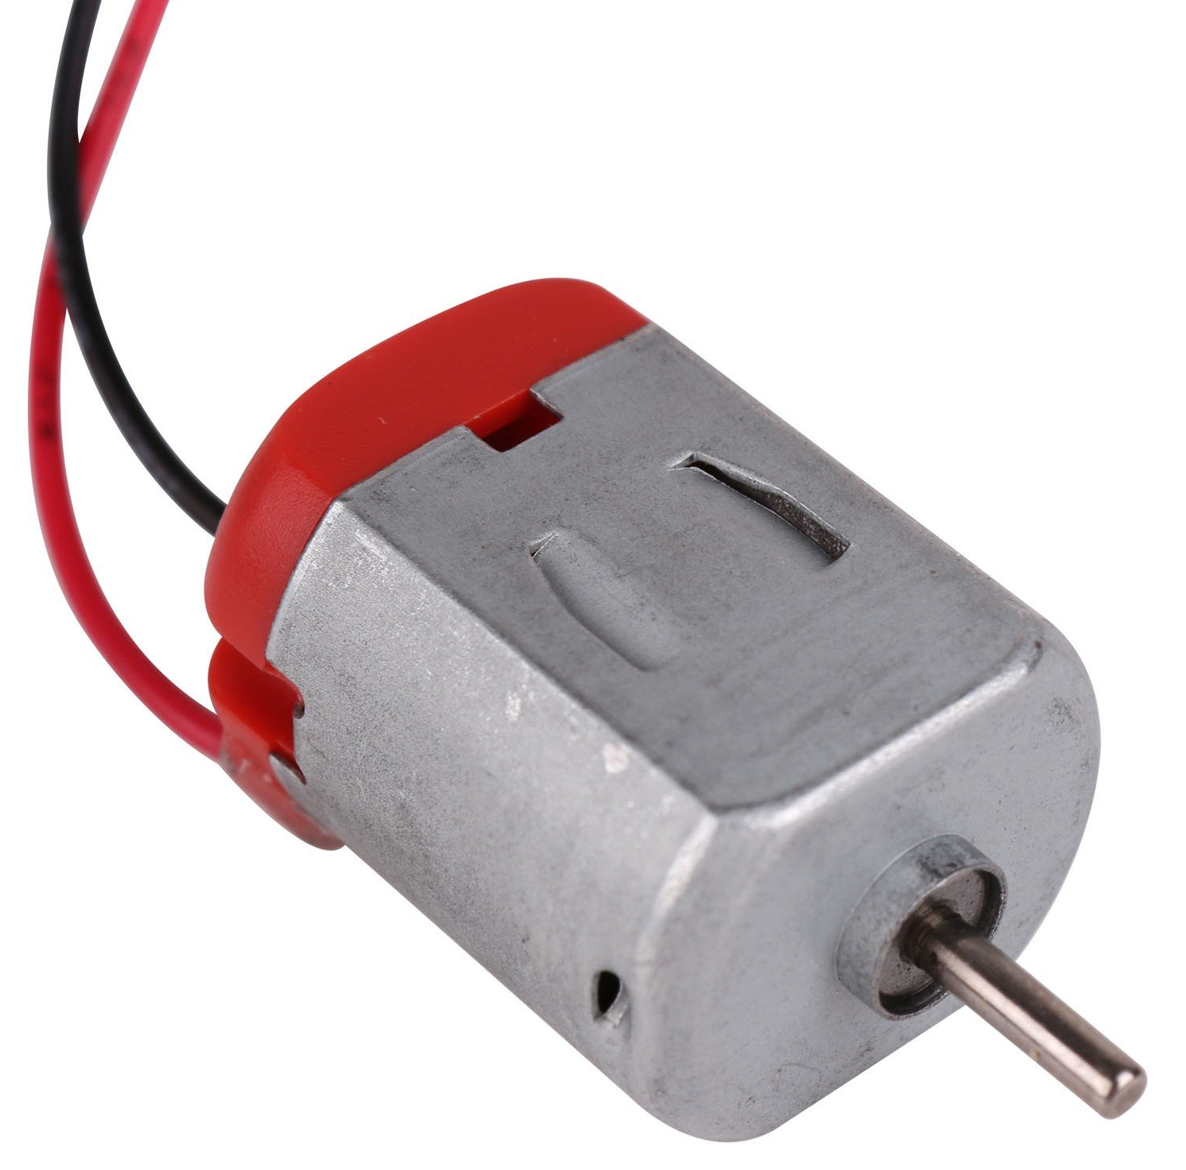
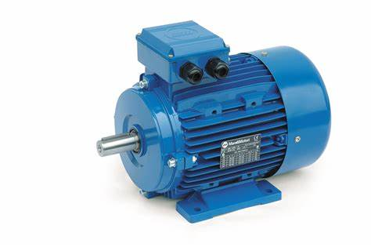
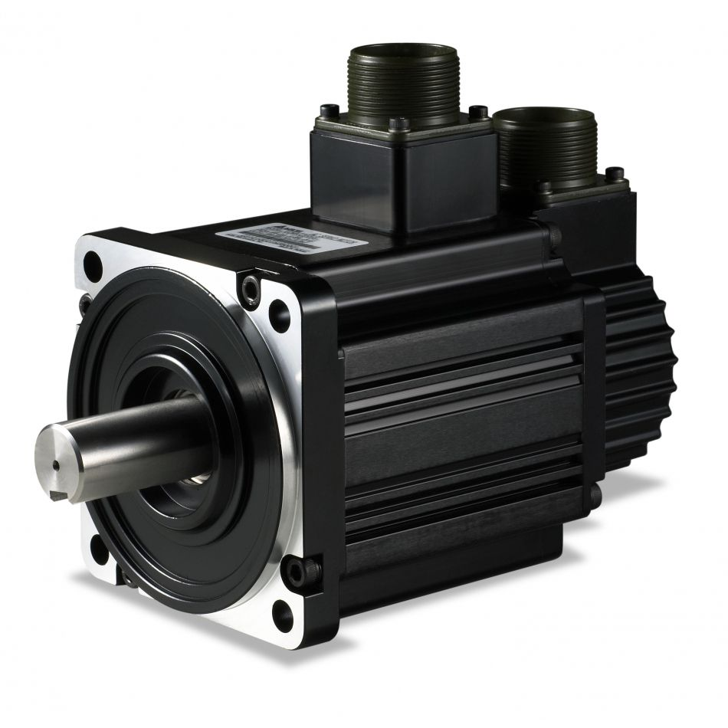
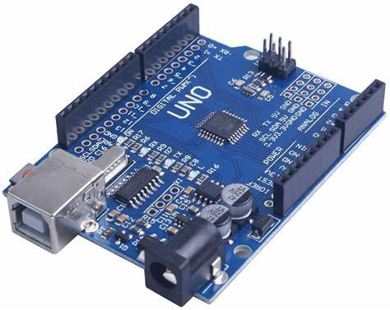
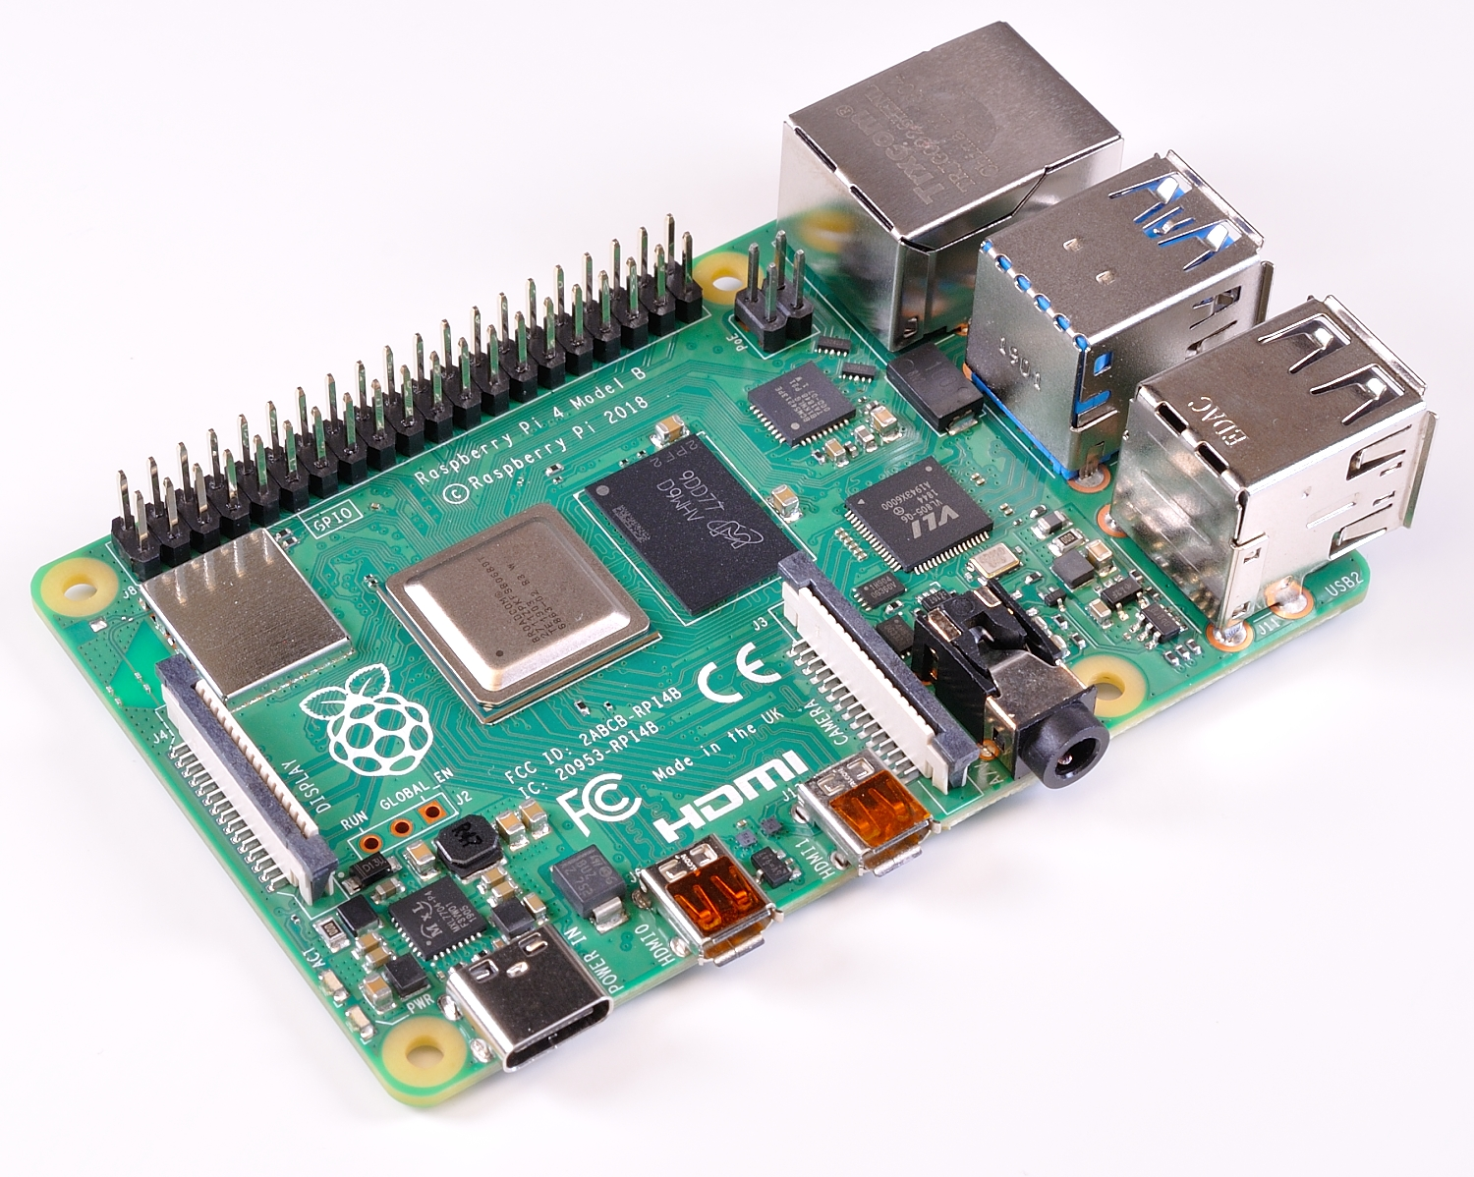
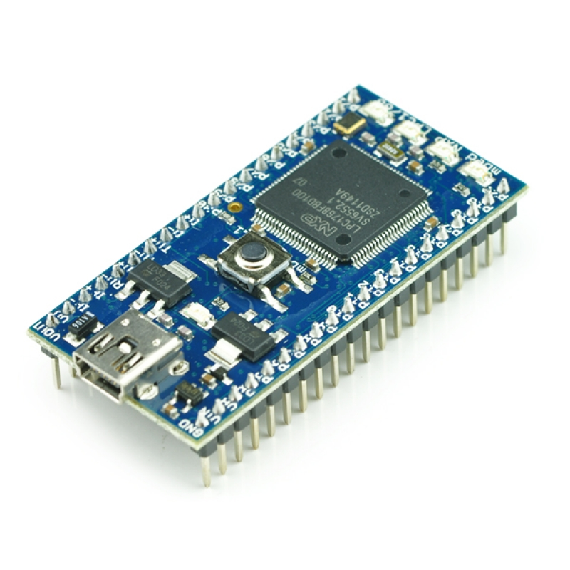

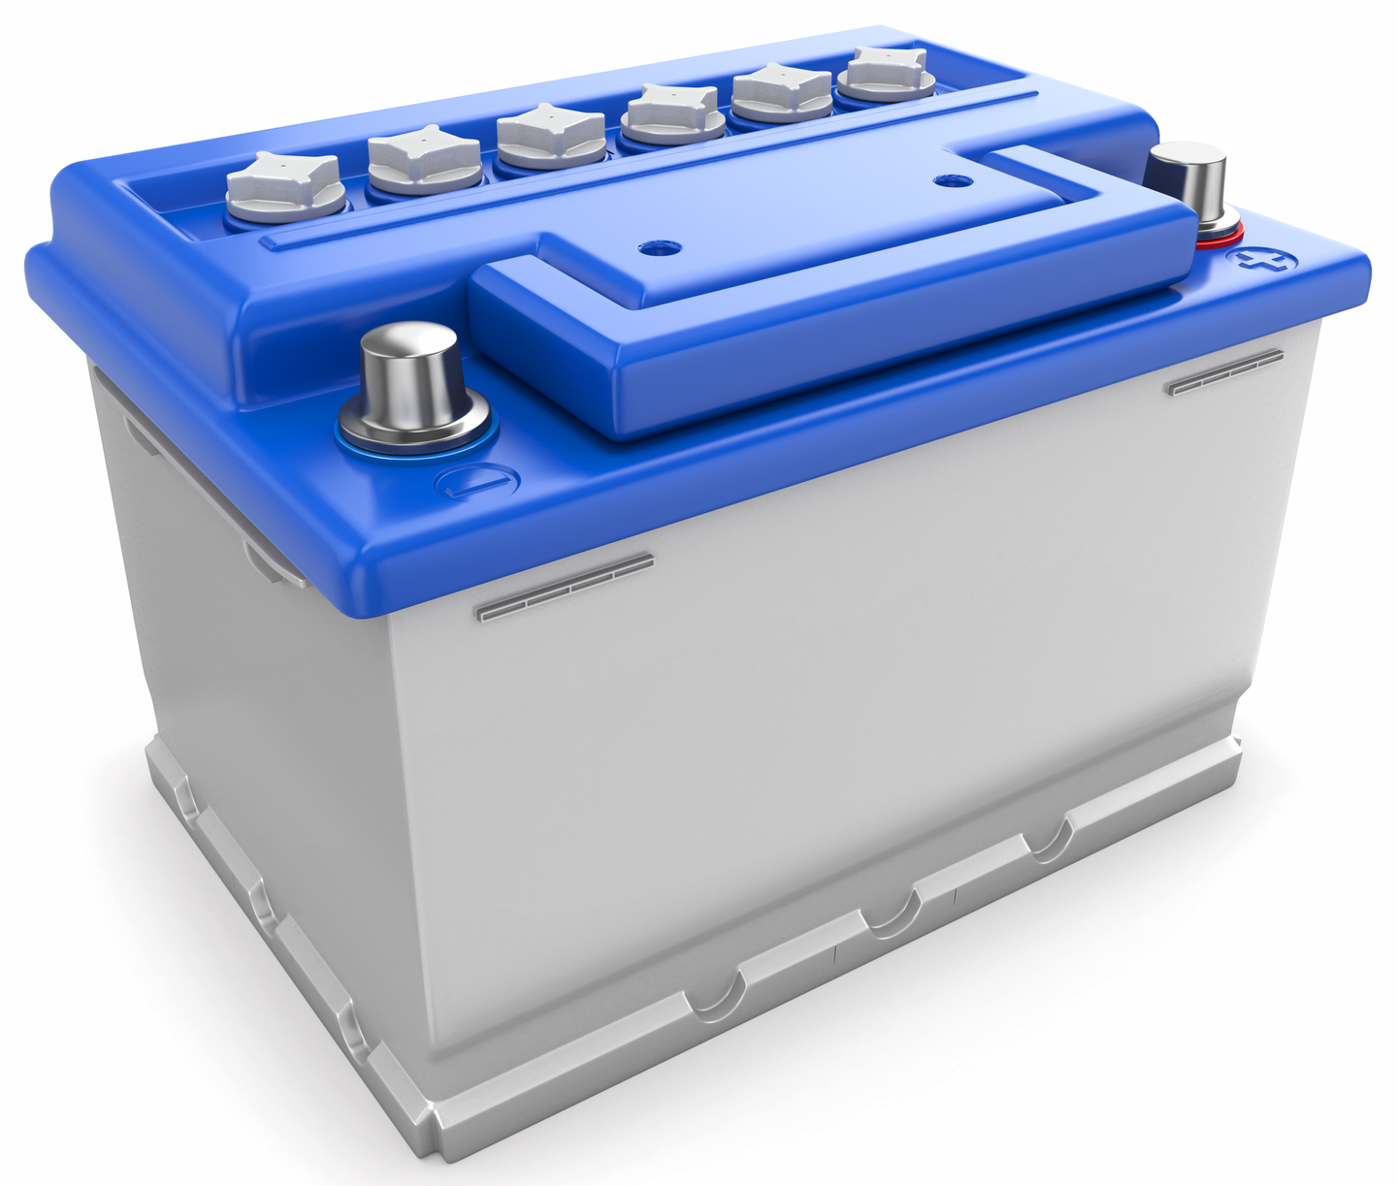
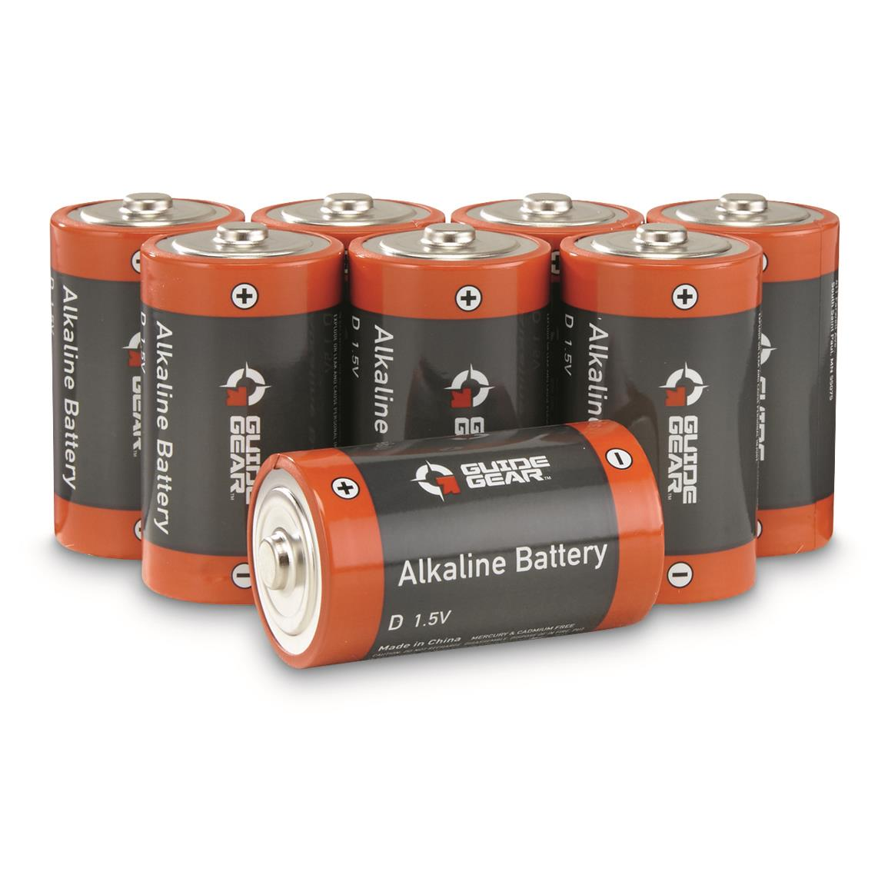



Design Concept: Electrical
Electrical Components Evaluation
Mandatory Criteria | Option 1 | Option 2 | Option 3
Location Positioning | GPS | On Dia-Bot algorithm with navigation and system map | Raw position data using telemetry
Movement Generation | DC Motors | AC Motors | Servo Motors
Processing Center | Arduino UNO Rev 3 | Raspberry Pi 4 | Mbed (LPC1768 Cortex-M3)
Power Source | Rechargeable: Lithium-ion battery | Rechargeable: Lead Acid or SLA Batteries | Non-rechargeable: Alkaline Cell Batteries (PP3)
Real Time Access to Dia-Bot Data | Wi-Fi | Bluetooth | Extra Long Wires
User Interface | Web Access through Computer or Tablet | Remote Control center with a fabricated push button interface | Virtual Reality Interface with Haptic Gloves

Slide 11
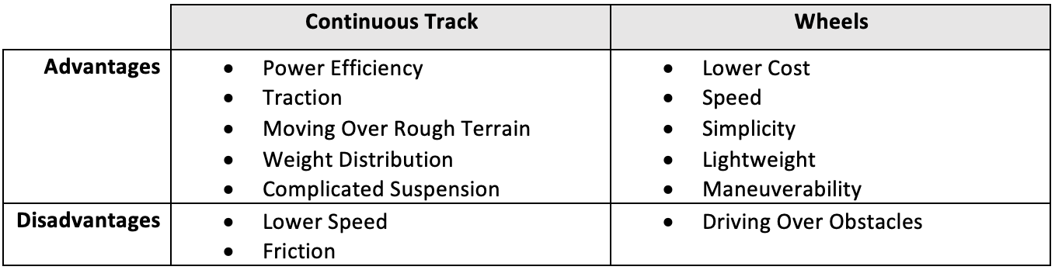
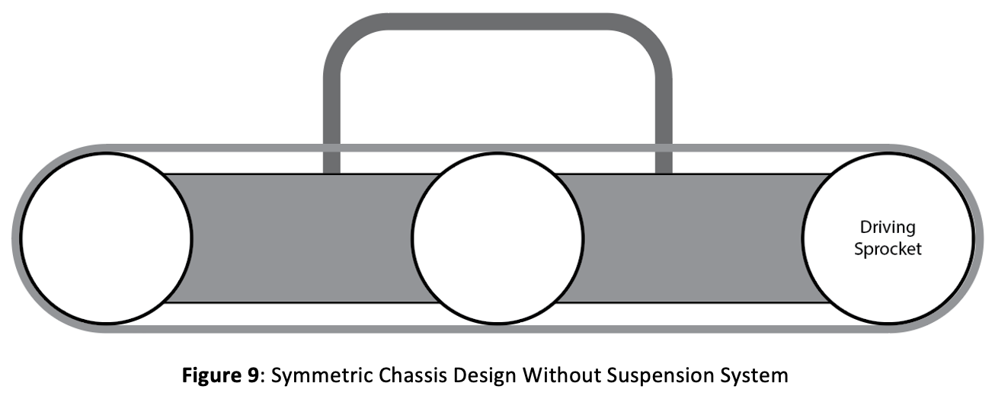
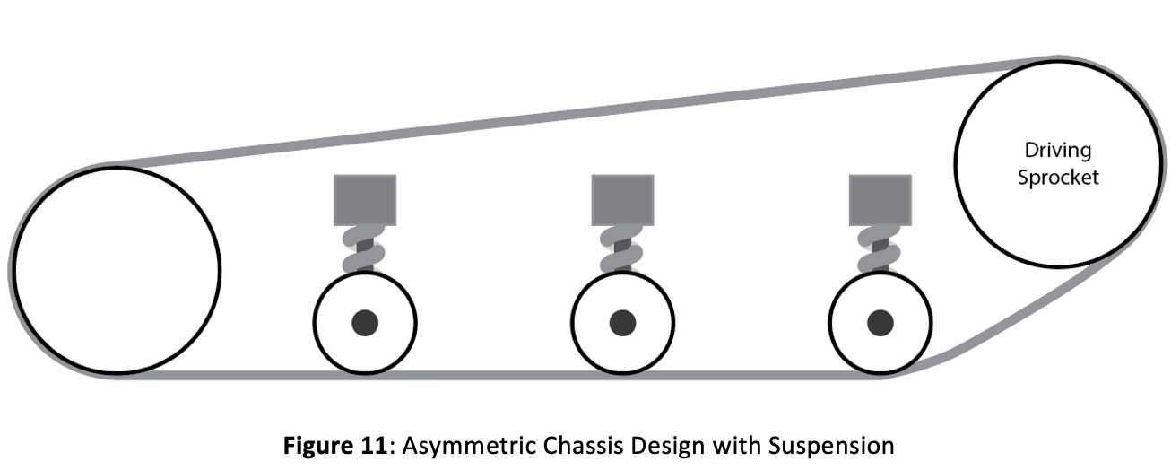
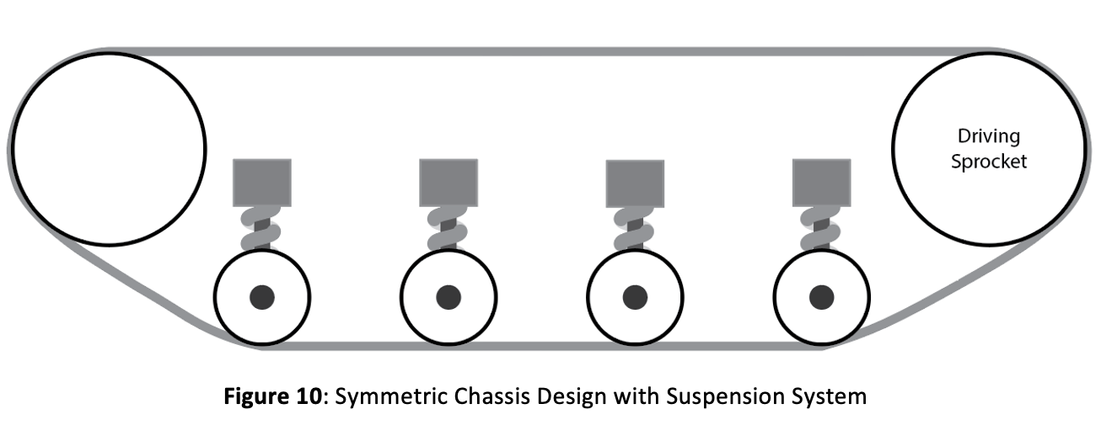
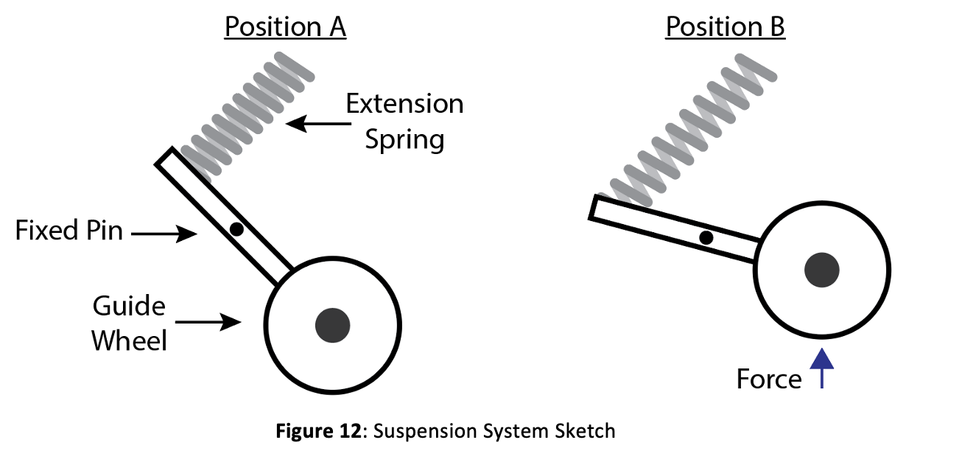
Design Concept: Mechanical Components
Concepts 1: Symmetric without Suspension
Concepts 2: Asymmetric with Suspension
Analysis of Continuous Track vs. Wheels:
Selected Design
Suspension Concept:
Concept 3: Symmetric with Suspension

Slide 12
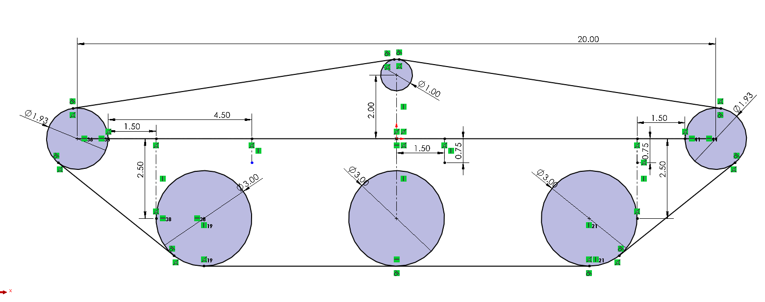
Layout Sketch of Chosen Chassis Design
Key Features:
Symmetric Design
Suspension System
Auto Tensioning of Chain

Slide 13
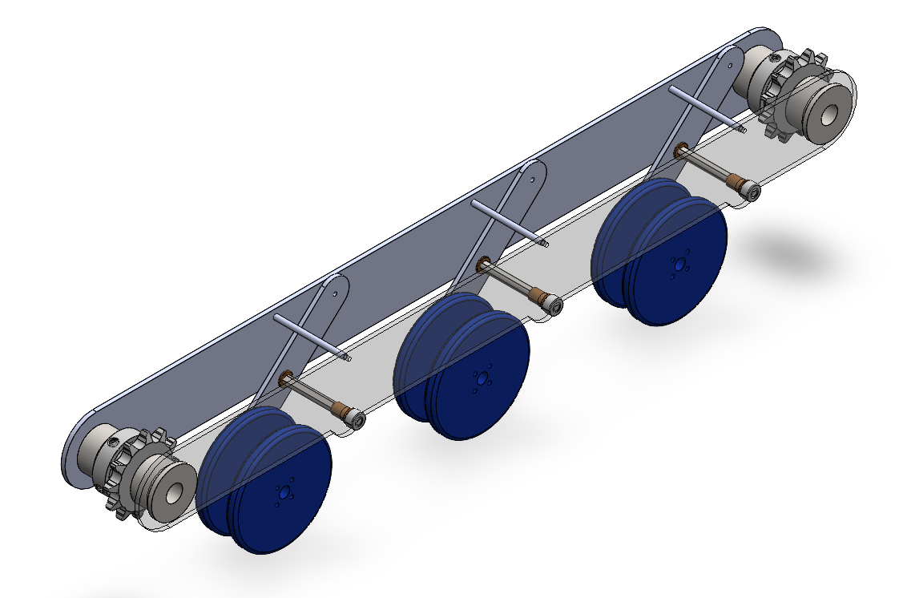
Chassis Assembly: Main Body and Suspension

Slide 14
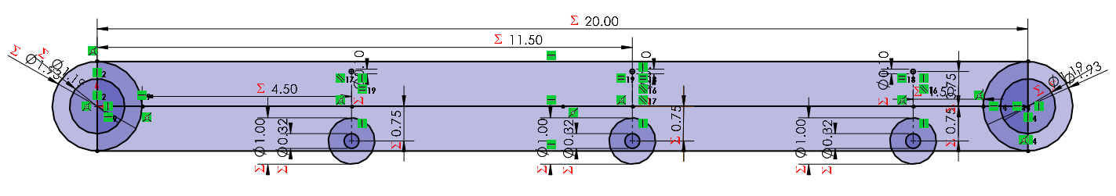
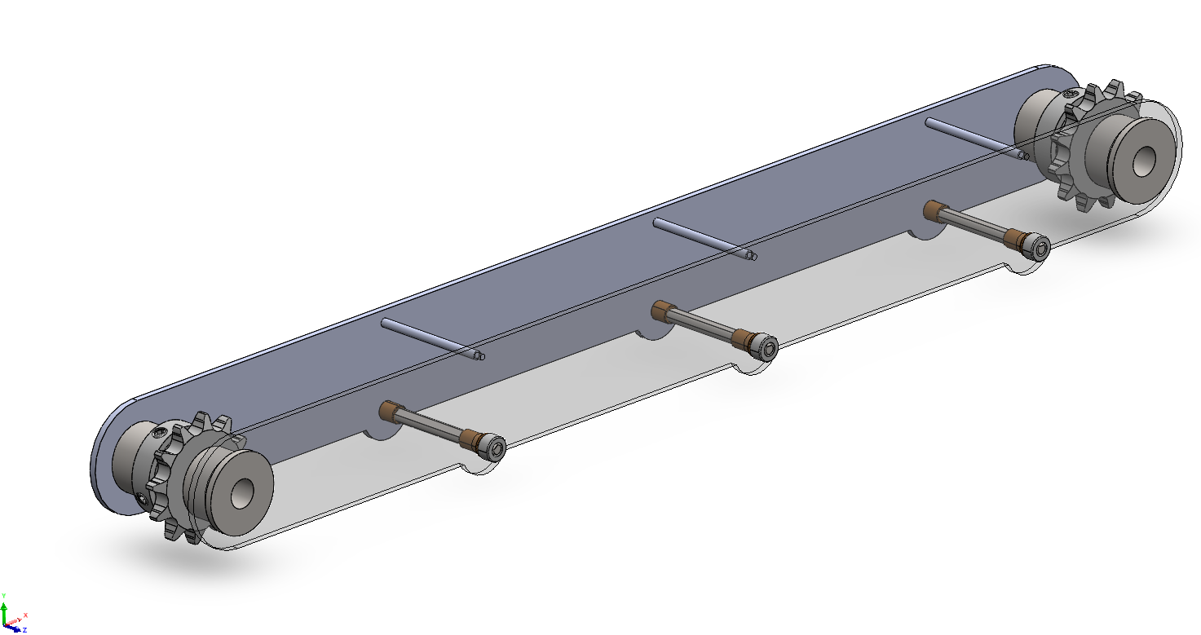
Chassis Frame

Slide 15
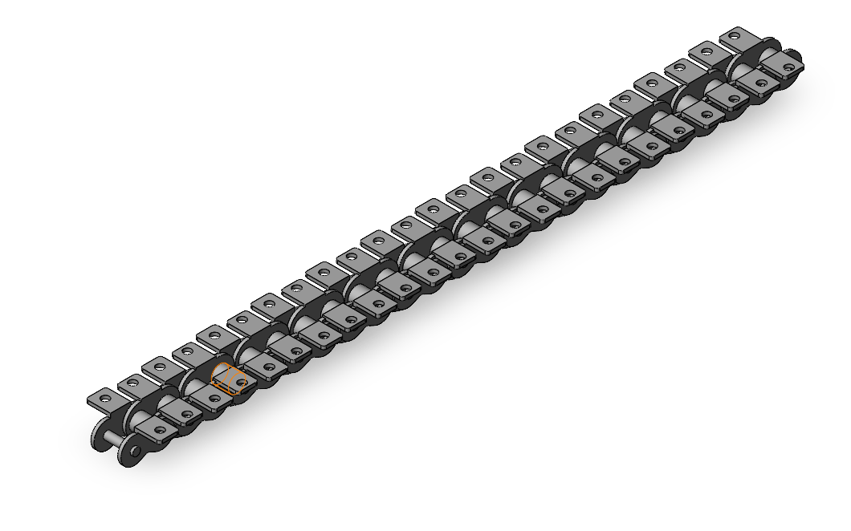
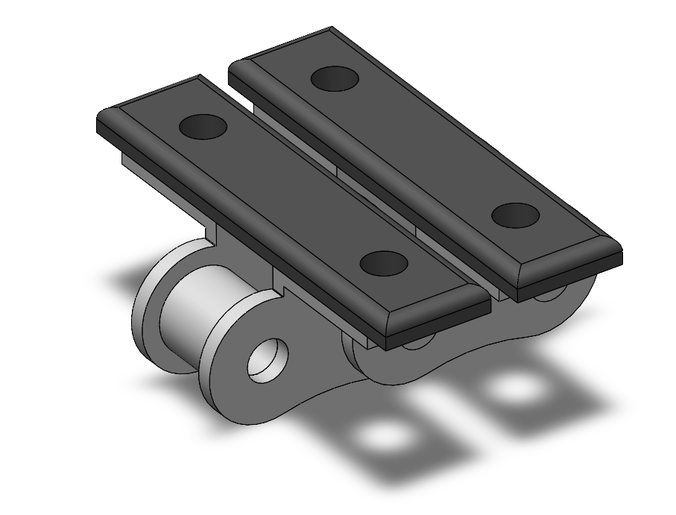
Tread: ANSI #40 Roller Chain with Flanges

Slide 16
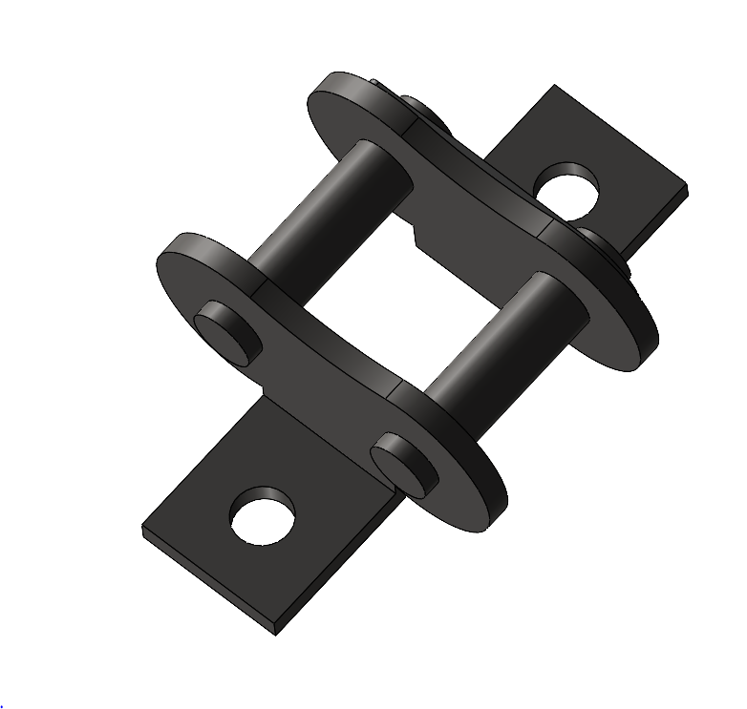
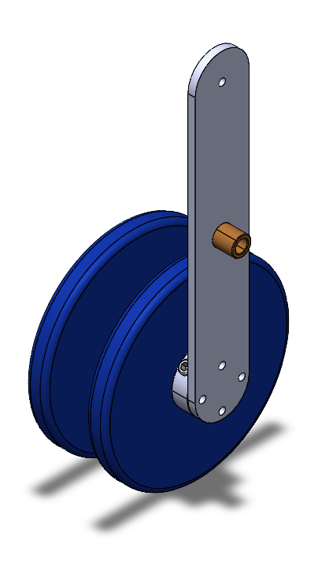
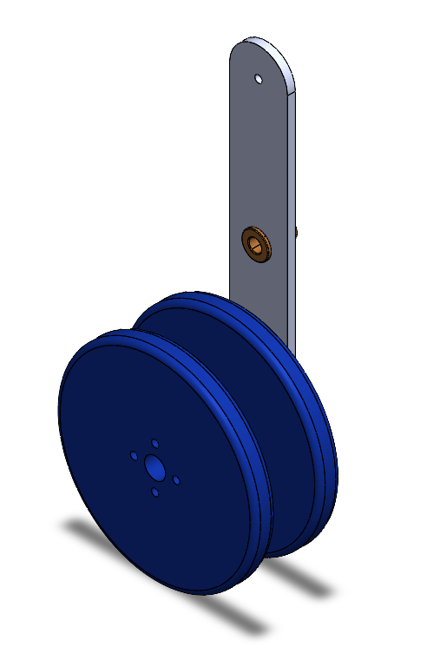
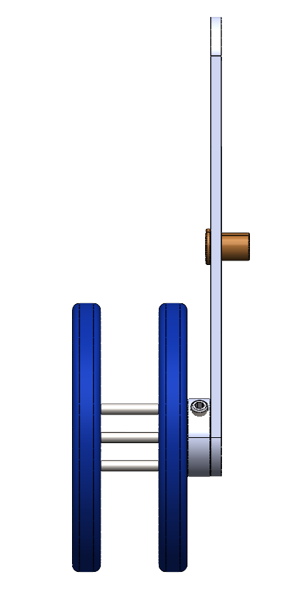
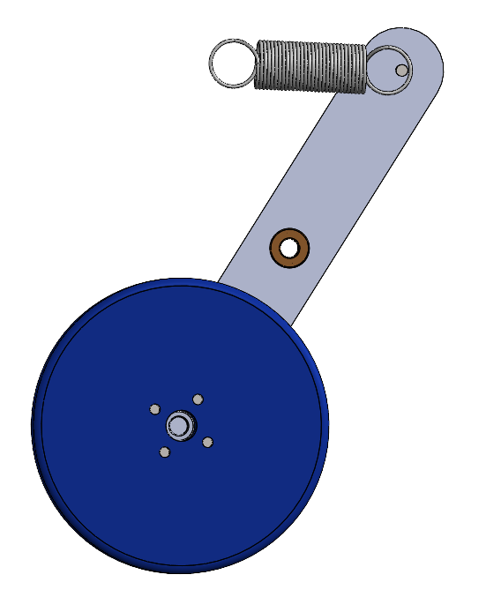
Suspension Assembly

Slide 17
Problem Alert Examples
Excessive force
Instantaneous accelerometer reading measures above a threshold
Excessive vibration
Vibrational magnitude at certain frequencies above a threshold for a certain period of time
Specific vibrational or combinational pattern detected
Ex. Resonant frequencies
Sound levels
Excessive sound energy over a certain length of time

Slide 18
Project Timeline
Key
Prototyping
Expo
Reports
Vanderlande Meetings
Engineering Feasibility Updates
Week
1
2
3
4
5
6
7
8
9
10
11
12
13
14
15
16
VM
VM
VM
VM
VM
VM
VM
VM
VM
VM
VM
VM
VM
Bids
Project Intro
Design Evaluation
Design Simulation
User needs, specs, standards & codes
Gather Materials
Build Enclosure
Build Movement Mech.
Build Power Subsystem
Thanksgiving Break
Ideation
Proposal
Build Electrical Subsystems
Report #1
Feedback
Build User Interface
Final Report & Fab Package
Report #2
Validate Prototype
Update
Update
Update
Update
Update
Update
Poster Draft
Capstone Expo
Final Poster & Video
Register for Expo
Today
Notes:
Vanderlande Meetings have been set up as weekly meetings, but if there is ever a need to extend or cancel a meeting, we will reach out to them 1 business day in advance and email them with our progress updates.

Slide 19
Appendix
Prototyping Progress

Slide 20
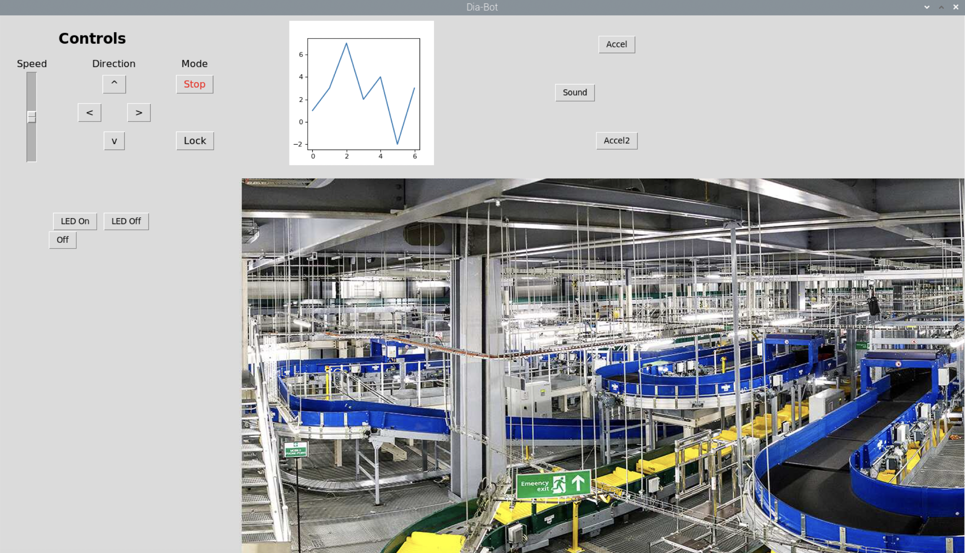
User Interface (Work in progress)

Slide 21
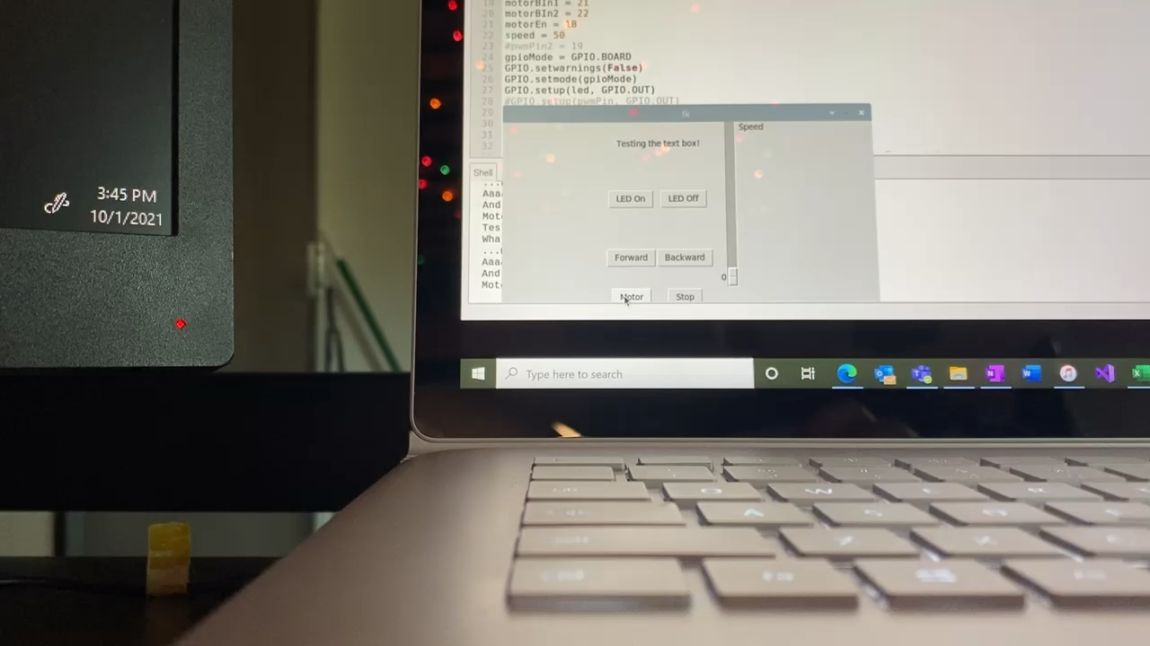
UI + Motor Interaction

Slide 22
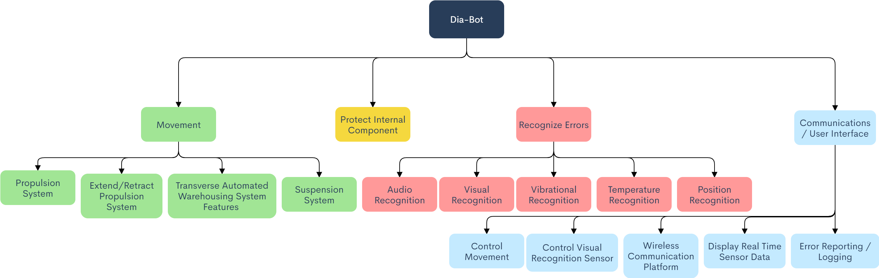
Previous Function Tree

Slide 23
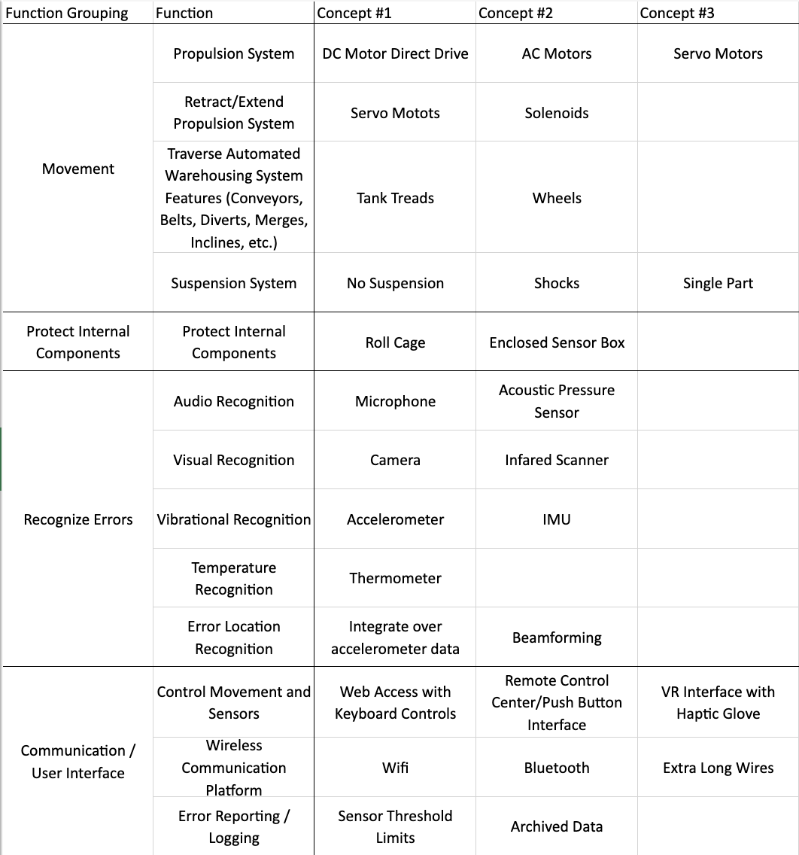
Design Concept: Morph Chart
Servo Motors

Slide 24
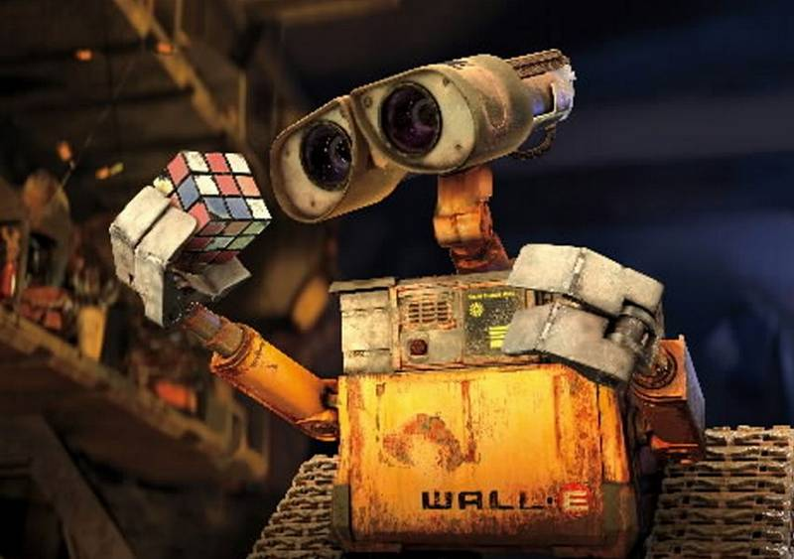
Stretch Goals & Future Work
Additional verification features
Semi or Fully autonomous driving and navigation
Swarm functionality with direct communication between bots
Computer vision integration for visual problem detection
Train other machine learning models for additional patterns
Investigate equipping the Dia-Bot with the ability to automatically fix certain common issues
Use in an installed system*
Device testing
Detect real problems
Collect position data
Verify and improve simulations
*Depending on Vanderlande’s client timelines, we may not get to test the Dia-Bot on a full system this semester
Notes:
Convert the following to bullet points:
As the full scope of detecting installation problems will not be realized in a semester project. Our goal is to give Vanderlande a functioning platform with the right tools to create future solutions.
This will be key to delivering a successful product, as more problems and use cases will undoubtedly be discovered over time.

